Slide 1
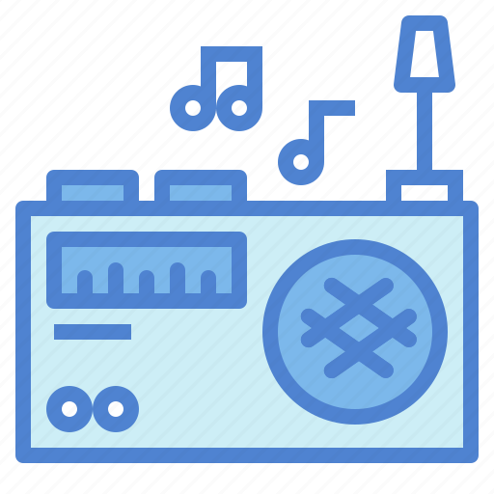
Software Defined Radio
SDR
Mariam Elseedawy 201901281
Gehan Sherif 201901989
Muhammed Khaled 201901493

Slide 2
TABLE OF CONTENTS
What is SDR?
Sampling Basics
Transmitter
Receiver
Resources
01
02
03
04
05

Slide 3
What is SDR?
01

Slide 4
Type of radio communication that uses software rather than hardware to process signals.
SDR just needs antennas and an ADC or DAC to convert signals from analogue to digital or from digital to analogue, respectively.
SDRs are more adaptable and simple to troubleshoot as they don't have to be pre-assembled.

Slide 5
Sampling basics
02

Slide 6
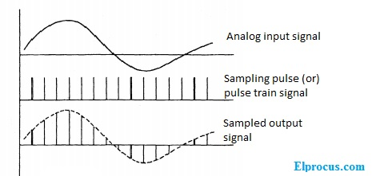
Sampling
Sampling is a fundamental concept in software defined radio (SDR) systems.
It involves the process of converting a continuous analog signal into discrete digital data points at regular intervals.
The sample rate, or the number of samples taken per second, determines the resolution of the signal and must be high enough to accurately represent the original signal.

Slide 7
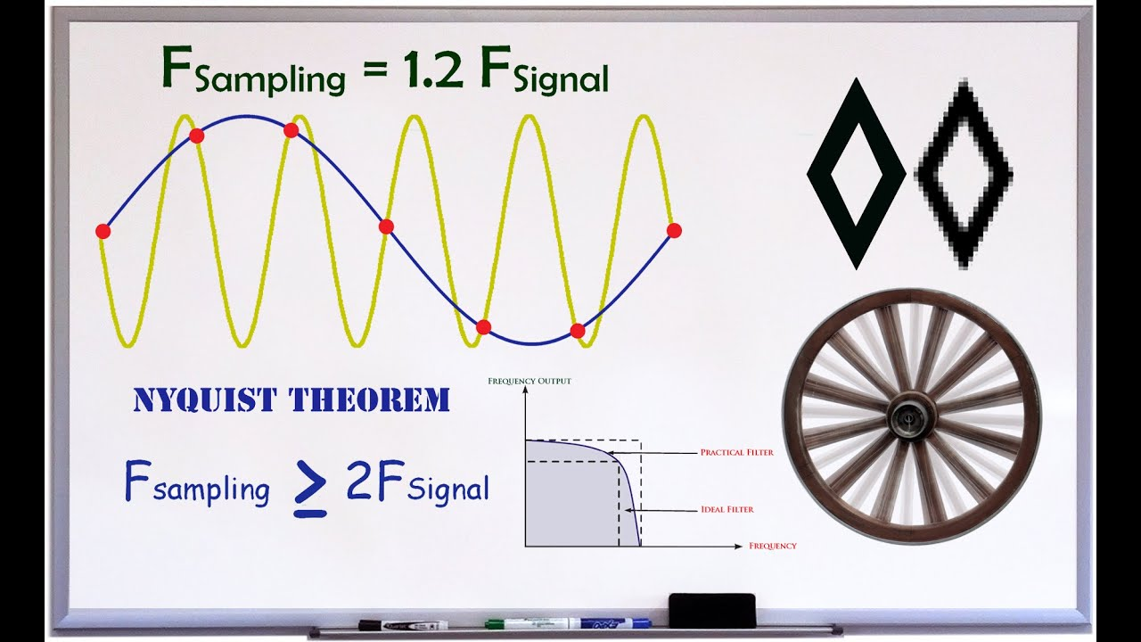
Nyquist theorem
Nyquist theorem is a fundamental principle in digital signal processing that states that the sample rate of a signal must be at least twice the highest frequency present in the signal in order to accurately reconstruct the original signal.
The figure shows how we can’t reconstruct the yellow signal as the sampling frequency is less than nyquist frequency.

Slide 8
Undersampling
Undersampling is a technique used in software defined radio (SDR) systems to reduce the sample rate of an incoming signal in order to reduce the amount of data that needs to be transmitted.
This can be useful in situations where bandwidth is limited, or when the signal contains only a small amount of information.

Slide 9
Transmitter
03

Slide 10
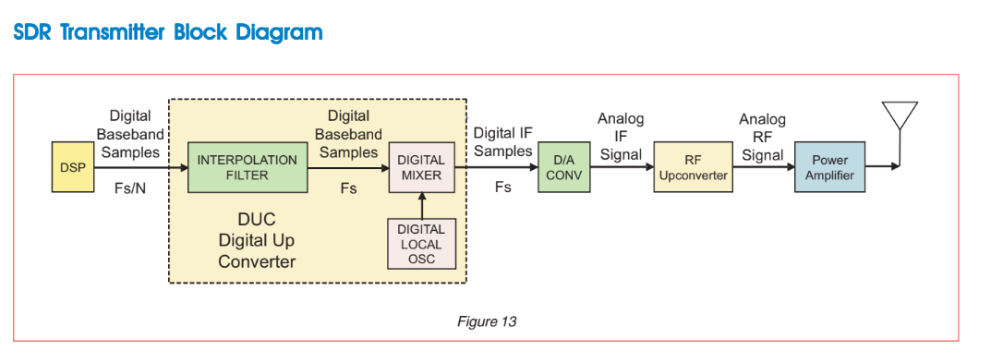
Block Diagram

Slide 11
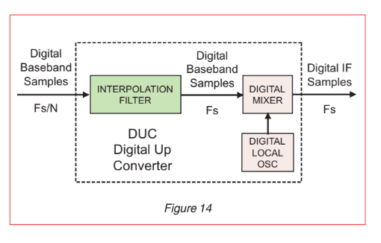
DUC Signal Processing
Digital Up Converter (DUC) converts the baseband signal to a higher frequency (Radio Frequency IF), this process is known as upconversion.
It consists of two main components:
The interpolation filter.
The digital mixer.

Slide 12
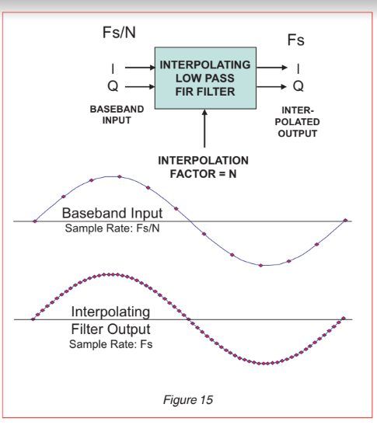
Interpolation Filter
The interpolation filter is used to increase the sample rate of the baseband signal by inserting additional samples between the original samples.
This process is also known as upsampling.
There are 3 types of upsampling:
zero padding interpolation.
trigonometric interpolation.
linear interpolation.

Slide 13
Digital Mixer
The digital mixer is used to shift the frequency of the upsampled baseband signal to the desired IF frequency.
This is done by multiplying the upsampled baseband signal by a complex sinusoidal function at the desired IF frequency.

Slide 14
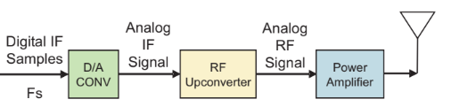
Transmitter
The output from DUC block passes through the following blocks:
1- The D/A converter that follows converts the digital IF samples into the analog IF signal.
2- The RF upconverter converts the analog IF signal to RF frequencies.
3- The power amplifier boosts signal energy to the antenna.

Slide 15
Receiver
04

Slide 16
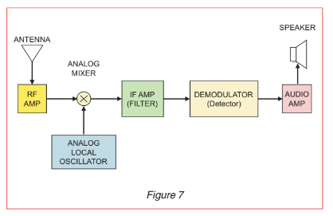
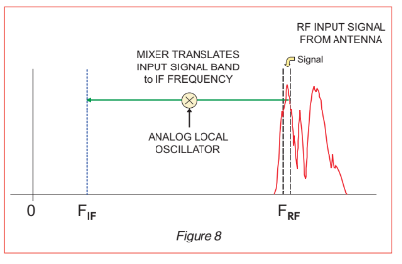
Basic analog receiver
Basic analog receiver
Basic digital mixer

Slide 17
Antenna: catch the received signal.
RF AMP: amplifies a region of the frequency band of interest.
Analog local oscillator: have the carrier
Analog mixer: apply “downconversion” or “translation”
IF AMP (filter): is a bandpass amplifier that only lets one signal or radio station through.
Demodulator (Detector): recovers the original modulating signal using one of several different schemes (AM or FM).

Slide 18
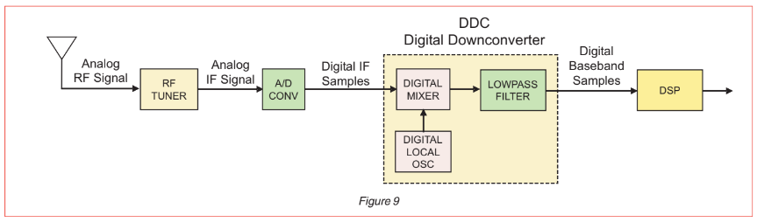
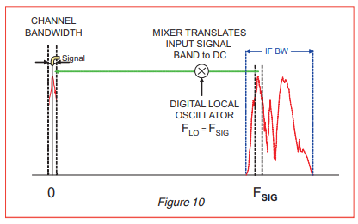
SDR analog receiver
SDR analog receiver
SDR digital mixer

Slide 19
Antenna: catch the received signal.
RF Tuner: converts analog RF signals to analog IF frequencies, the same as the first three stages of the analog receiver (RF AMP, Analog local oscillator, and Analog mixer).
A/D CONV: digitizes the IF signal
DDC: is typically a single monolithic chip or FPGA IP.
Digital mixer: same as in the basic receiver, but here, the complex representation of the signal allows us to go right down to DC instead of mixing which was done down to an IF frequency .
FIR lowpass filter: limits the signal bandwidth and acts as a decimating lowpass filter

Slide 20
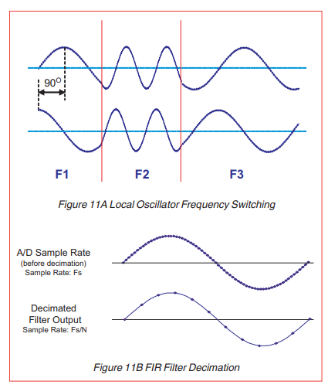
Digital local oscillator:
Output is DC as complex I and Q components with a frequency shift equal to the local oscillator frequency.
There is no aging, drift or calibration since it’s implemented entirely with digital logic.
It switches between frequencies with phase continuity, so you can generate FSK signals or sweeps very precisely with no transients as shown in Figure 11A.
Since the output of the FIR filter is band limited, the Nyquist theorem allows us to lower the sample rate. If we are keeping only one out of every N samples, as shown in Figure 11B above, we have dropped the sampling rate by a factor of N.

Slide 21
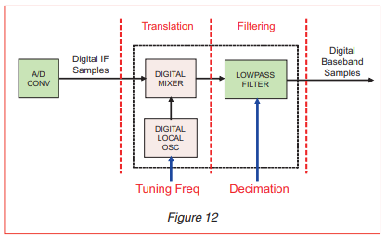
DSP: performs tasks such as demodulation, decoding and other processing tasks.
Frequency translation with the tuning controlled by the local oscillator.
Lowpass filtering with the bandwidth controlled by the decimation setting.

Slide 22
RESOURCES
https://drive.google.com/file/d/1qXw7ymGSr__JQSGh-AvudrAdWWodjgYC/view
https://www.youtube.com/watch?v=BK9QkHxeYQI
https://www.youtube.com/watch?v=bVLazRrhSRk&list=PL-XWNe_oYcGMgufBBqfYQrB16M21X1jT4&index=8

Slide 23
Thank you!

